Slide 1
Food Wastage Reduction App

Slide 2
Introduction
The purpose of this development is to limit the wastage of food.
Many restaurants tend to throw the leftover food at the end of the day even though the food is perfectly fine to be eaten, which means that huge amounts of food are wasted.
While all that food is being wasted, some families can barely afford proper meals with their limited money.
They don't get enough nutrition due to the lack of having three meals in a day.
Therefore, we decided to create our application to link the restaurant with the unfortunate people, so instead of throwing the food, the unfortunate will be able to pick it up from the restaurant at the end of the day.
The application allows the restaurants to log in, and upload an image of the meals they have as leftovers along with a description of that meal, and the location where to pick it up.

Slide 3
Modules
Users Register
This module is used to create a user registrations form. After registering application form the users able to enter into process. To register the form following details should be given by the user, the details that should be filled by the user is their personal details and the required details by the secret password, location, address etc.
Login
User can login using username and password
View Items
Search location wise and book the food items
Add Items
Create a new food item with details of quantity, location, address contact
Add images
Add images to the food items
Add Items To Cart
Add multiple food items to cart for booking
Remove An Item From The Cart
Delete food items to cart for booking

Slide 4
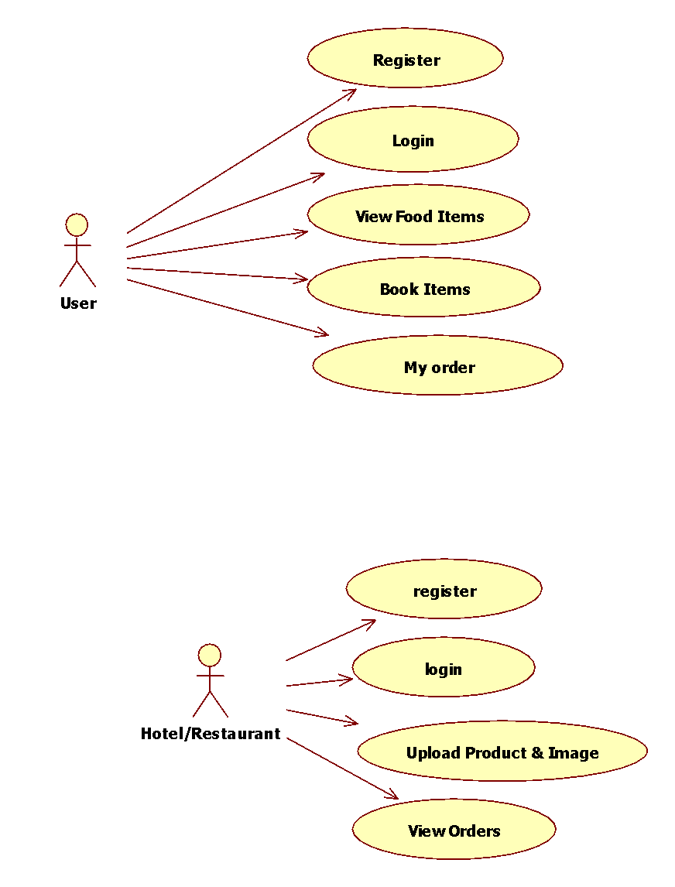
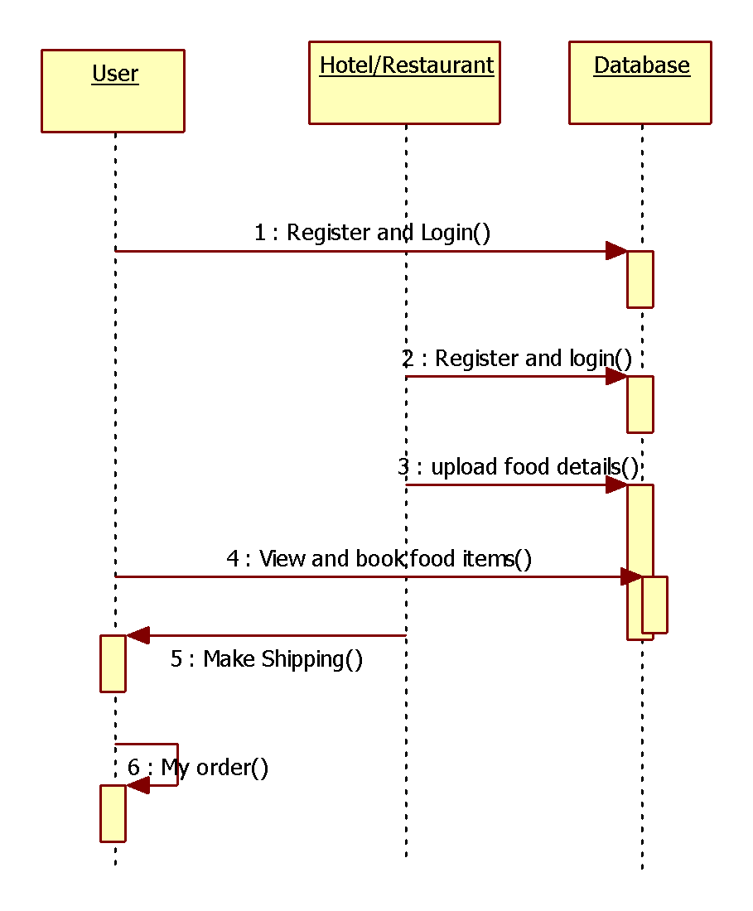
Use case & Sequence Diagrams

Slide 5
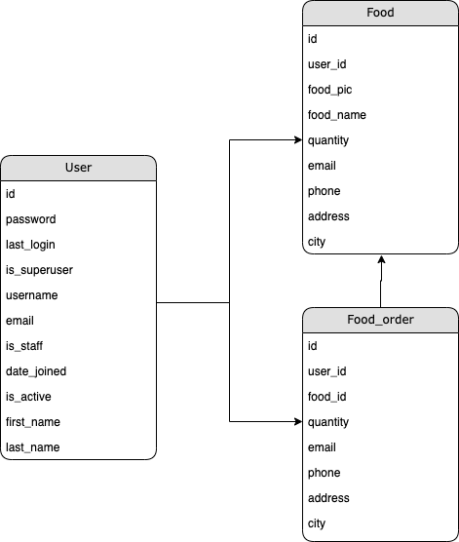
Database Model

Slide 6
Tools & Technologies
Python3
Django
HTML
MySQL
CSS & Bootstrap

Slide 7
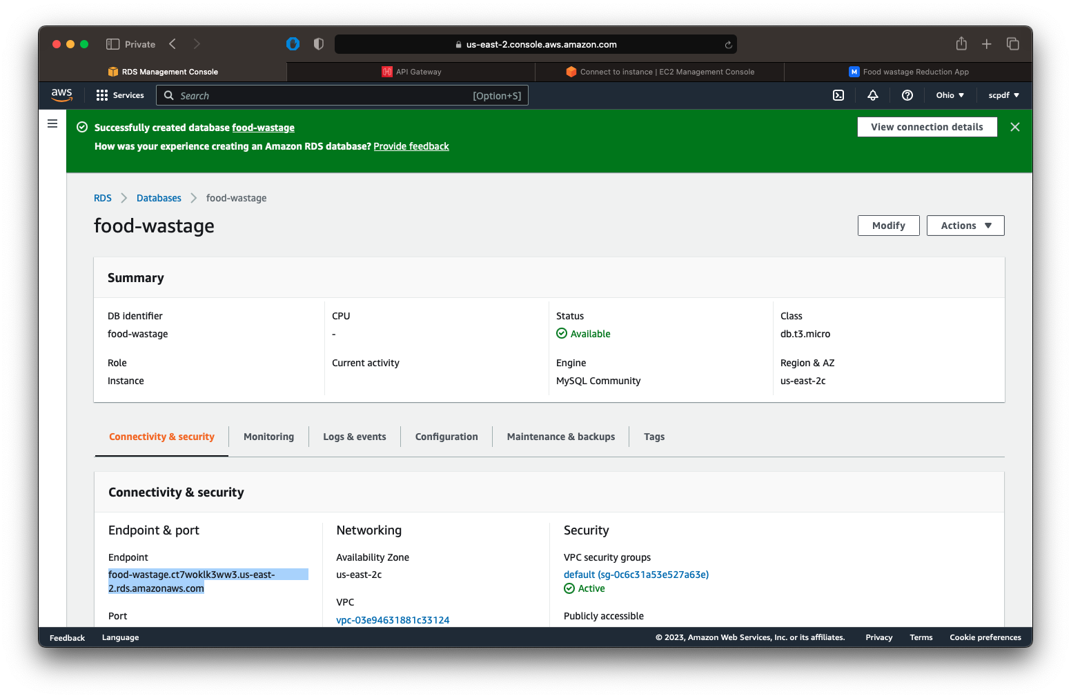
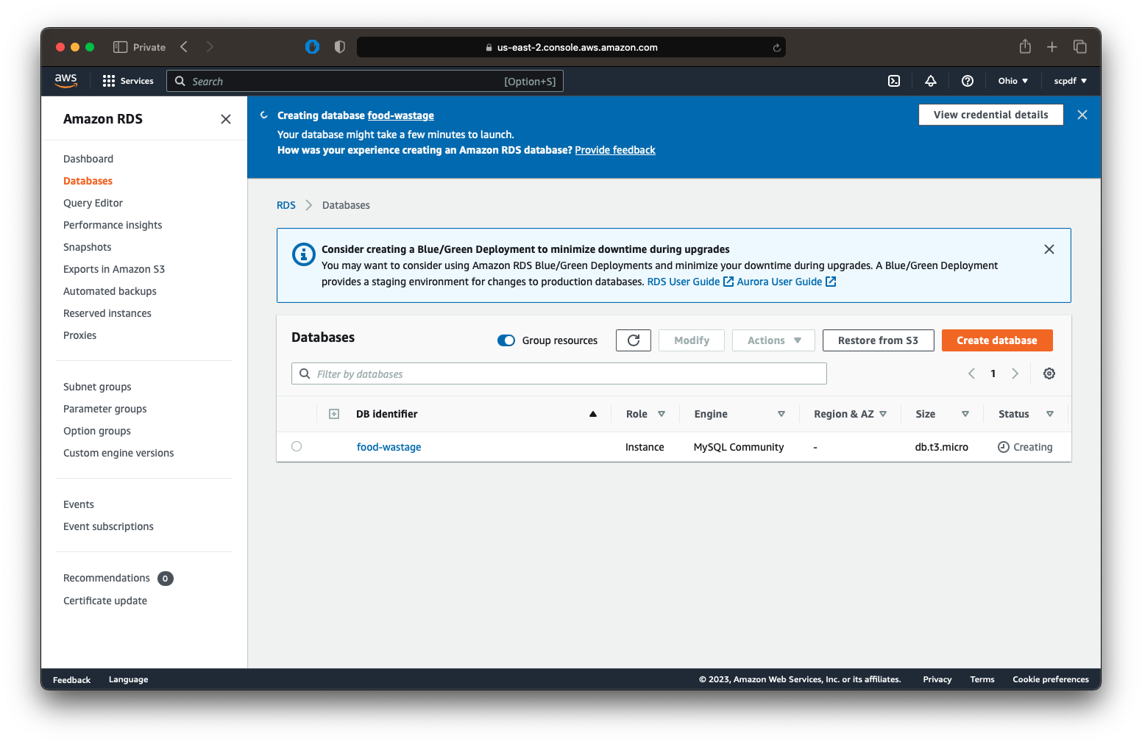
Deployment Services
AWS RDS

Slide 8
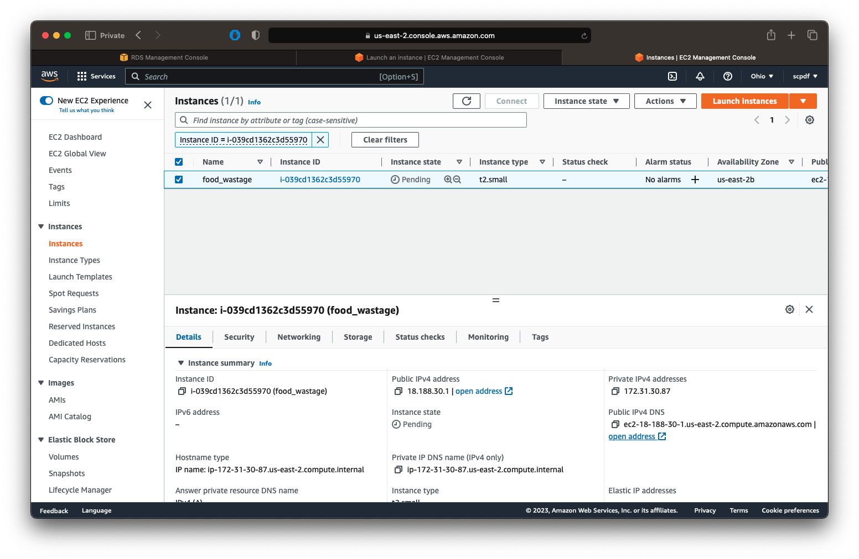
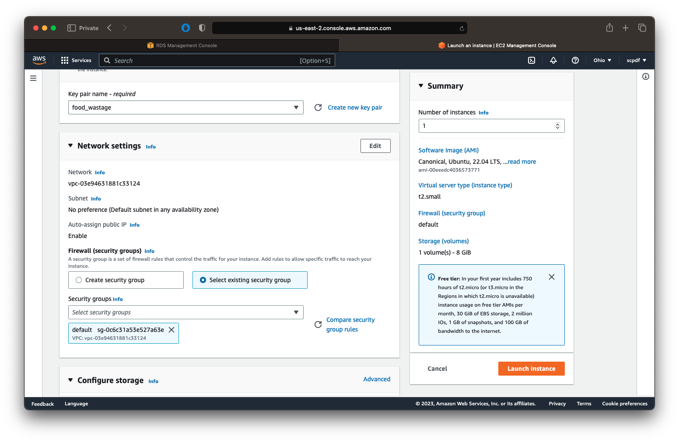
Deployment Services
AWS EC2

Slide 9
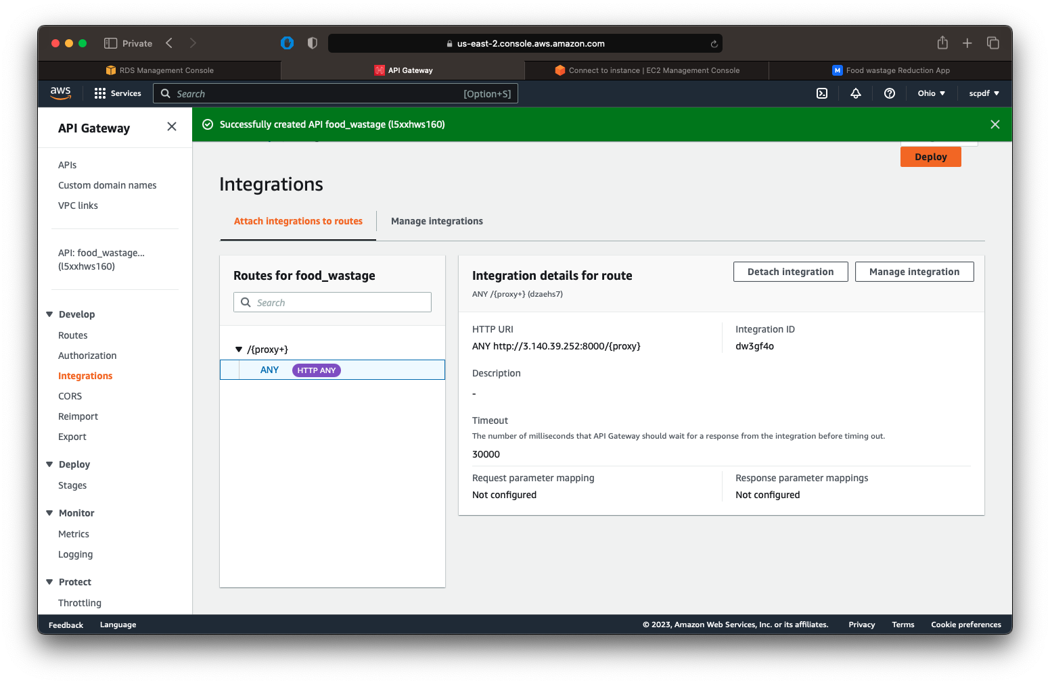
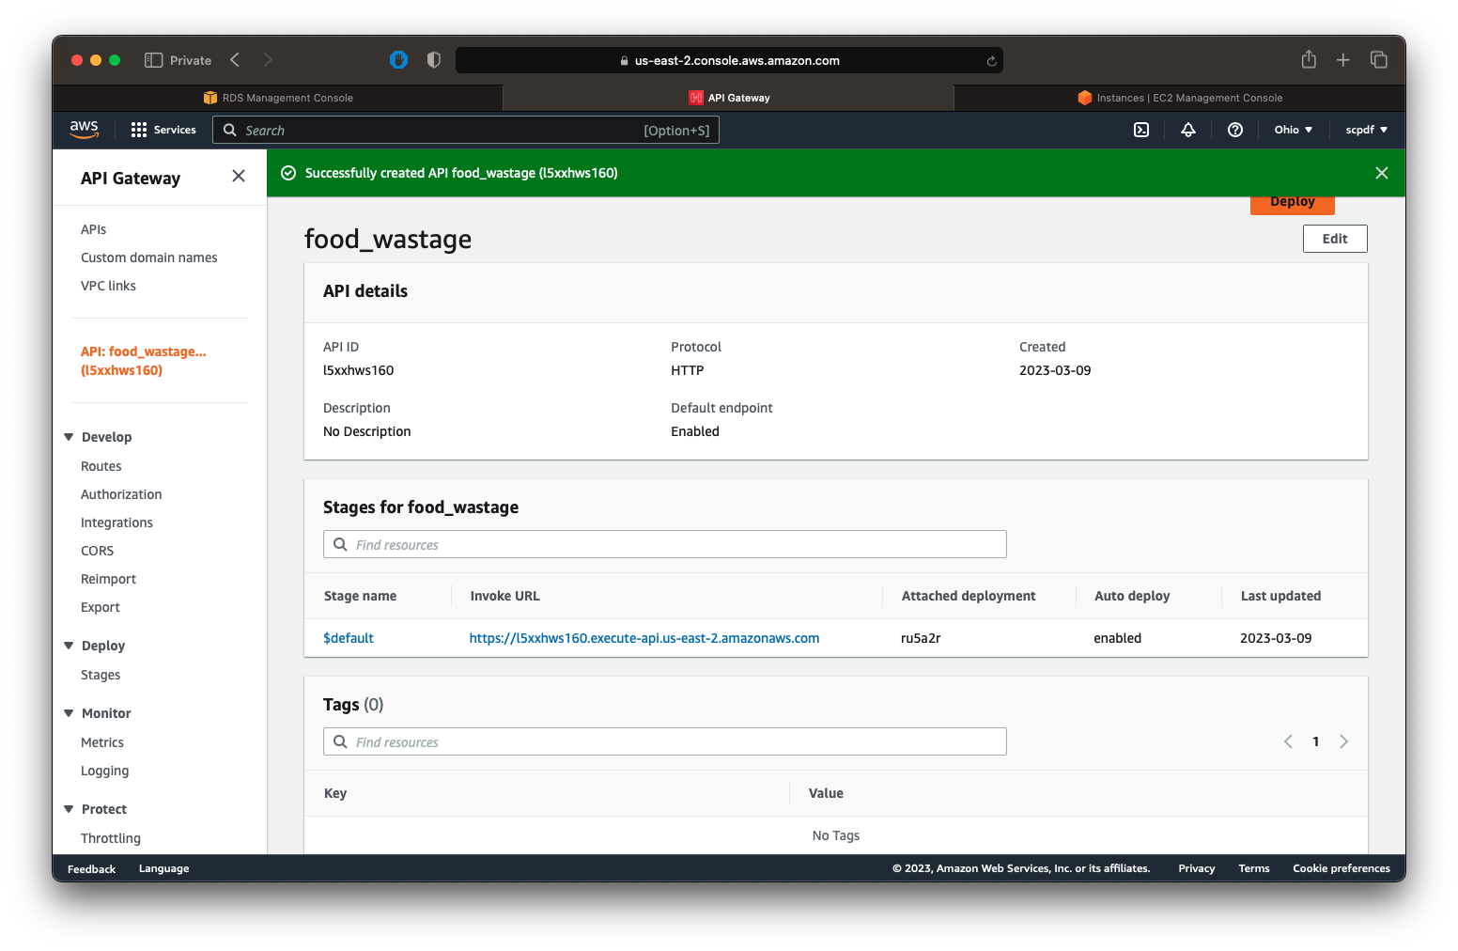
Deployment Services
AWS API Gateway

Slide 10
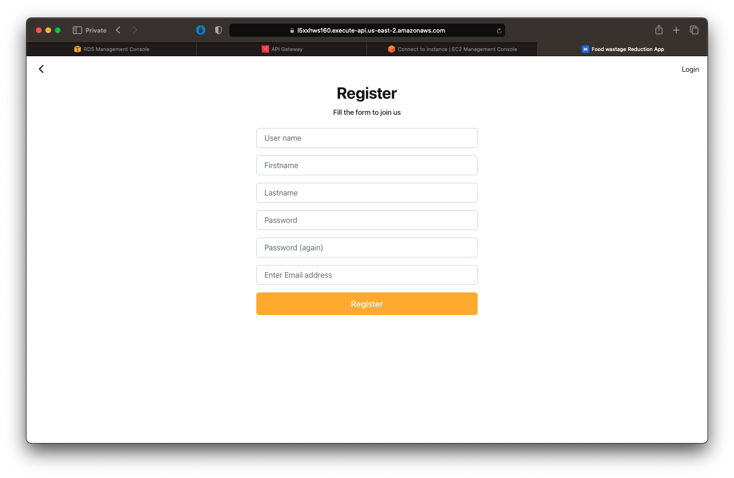
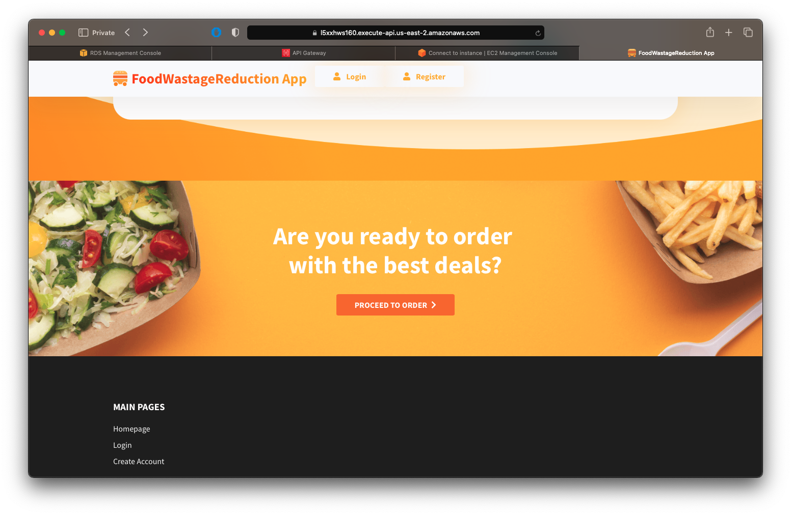
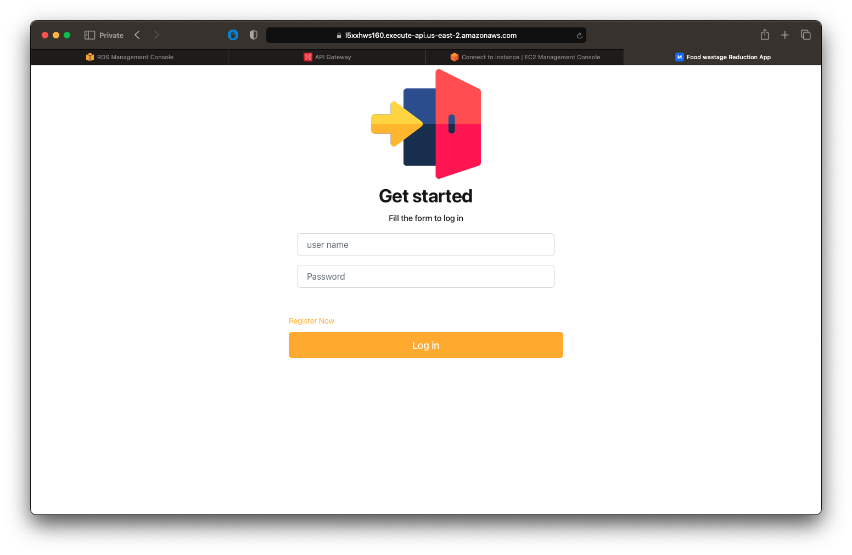
Food Wastage Reduction APP

Slide 11
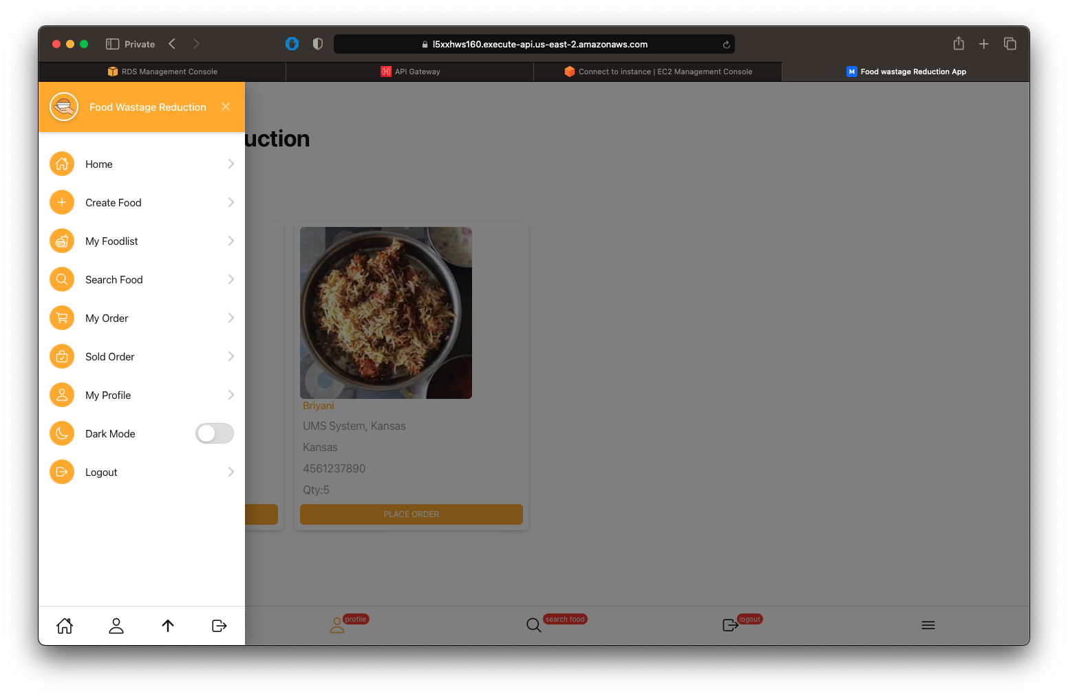
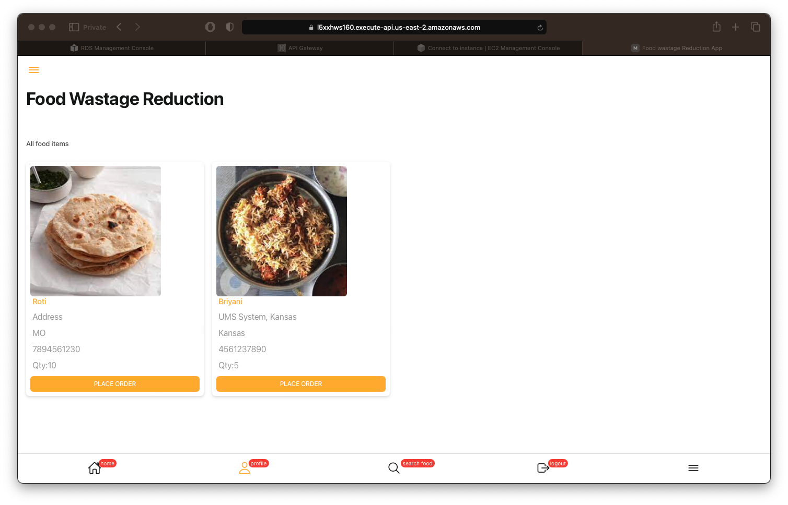
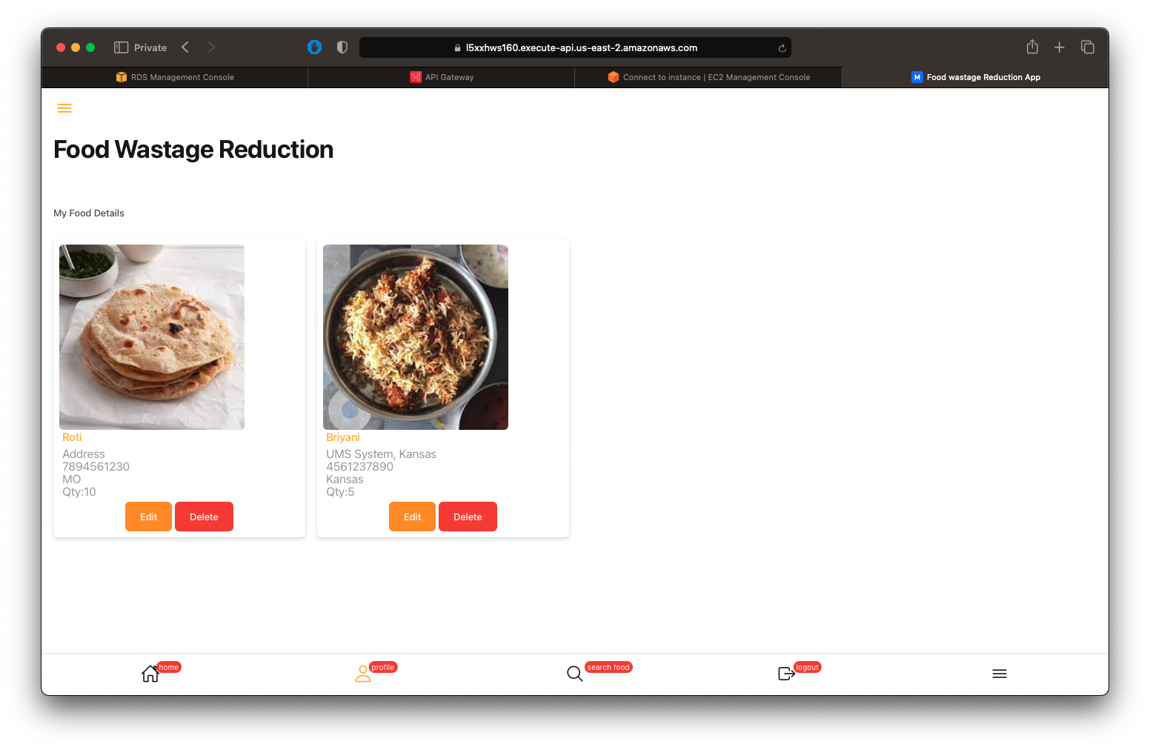
Food Wastage Reduction APP

Slide 12
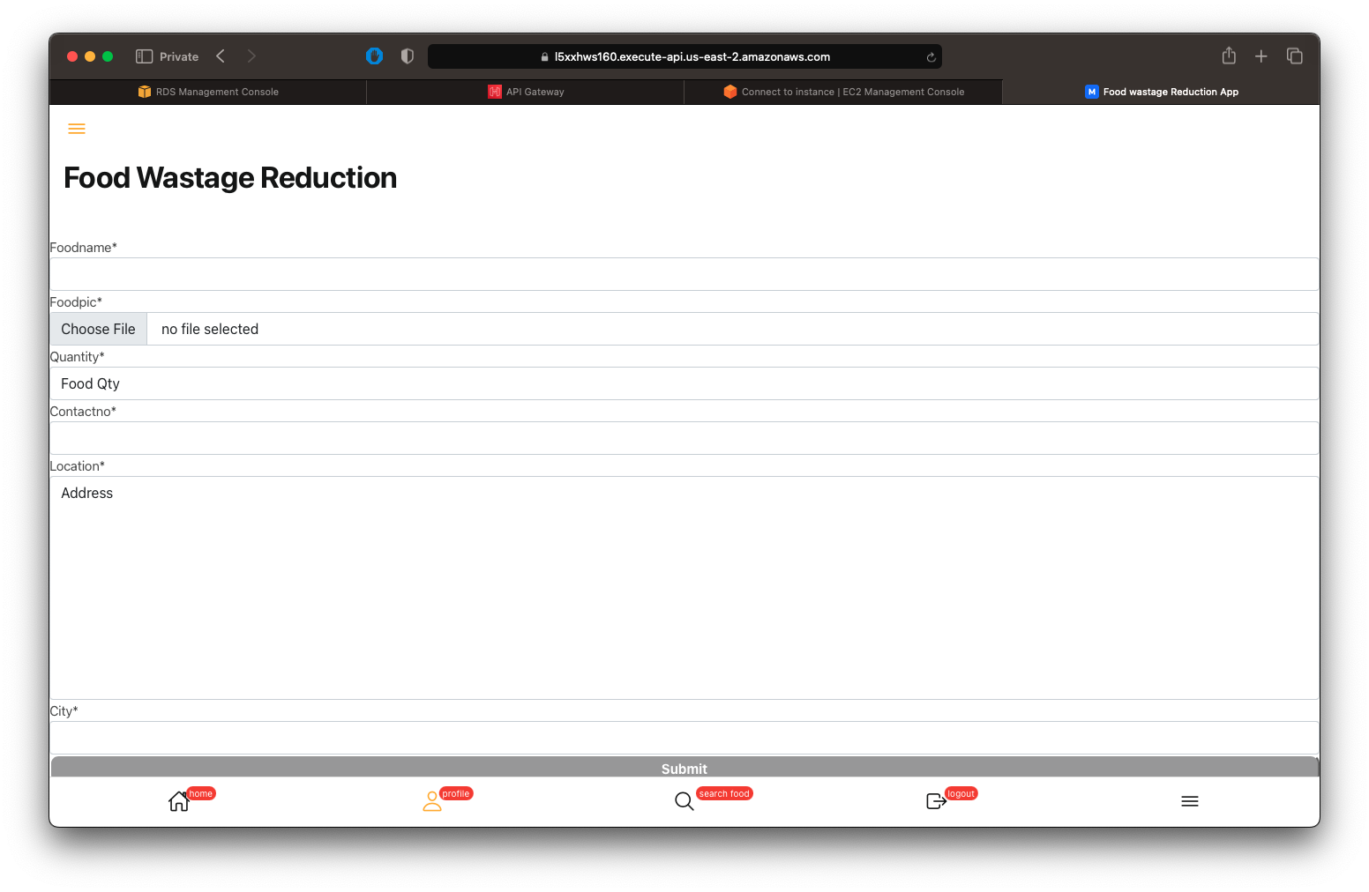
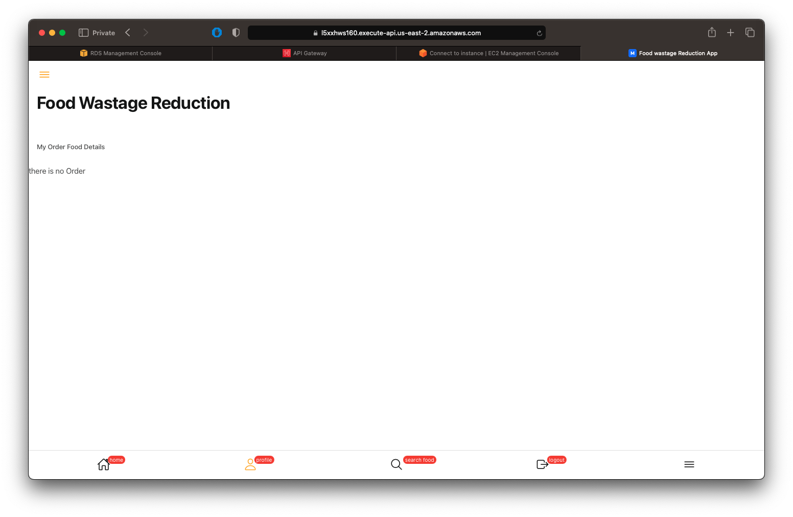
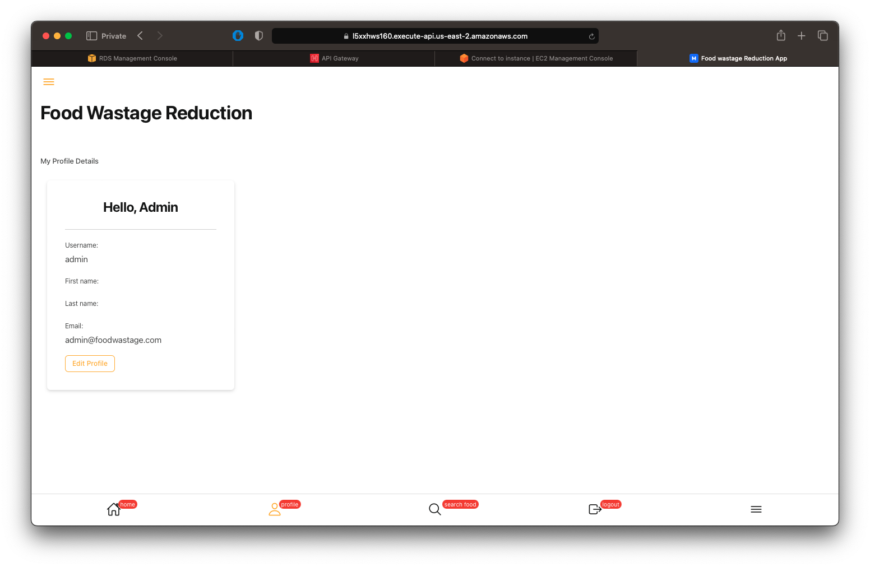
Food Wastage Reduction APP

